Slide 1
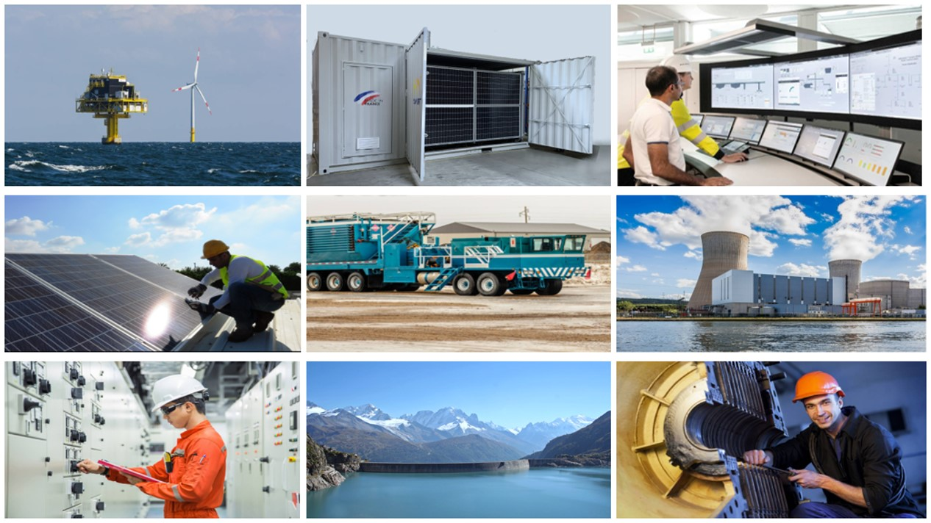
May 2022
1
1

Slide 2
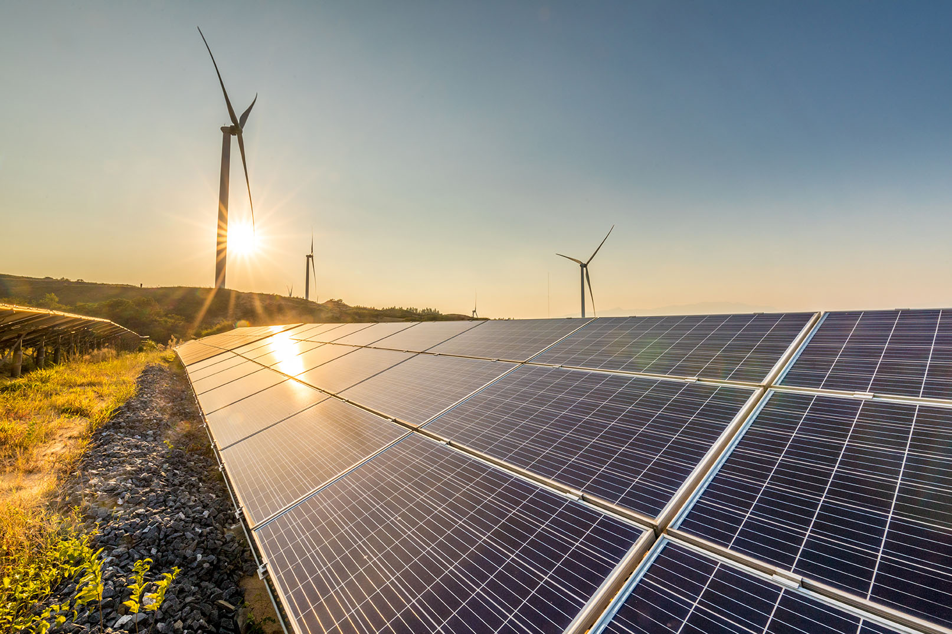
A French company invested in the energy transition
CMR GROUP HAS BEEN INNOVATING IN THE ENERGY SECTOR FOR 60 YEARS
2

Slide 3
CMR Group, an energy expert for 60 years
Our clients, the largest engine manufacturers and energy players, in France and abroad
Founded in Marseille, France, in 1959, CMR Group is a recognised player in instrumentation, automation
and electrical engineering. The company is present in the fields of energy, industry and marine.
Our financial partners
Our technical partners

Slide 4
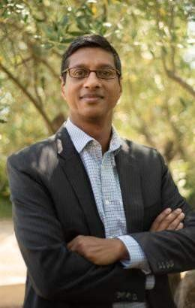
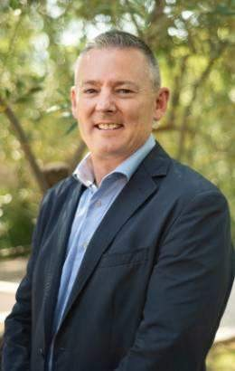
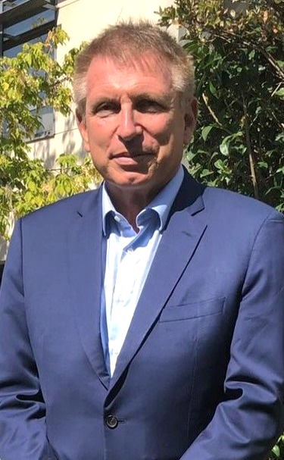
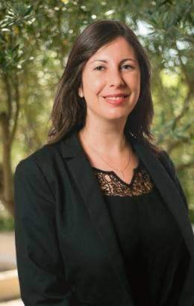
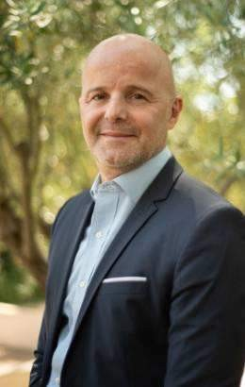
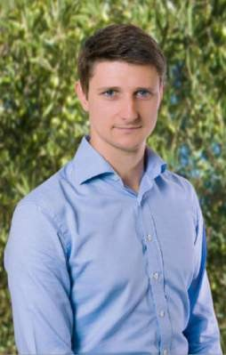
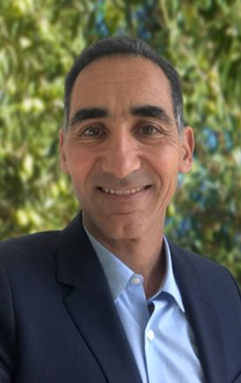
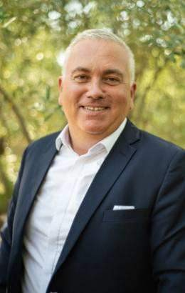
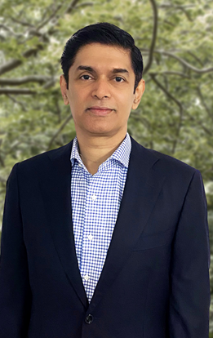
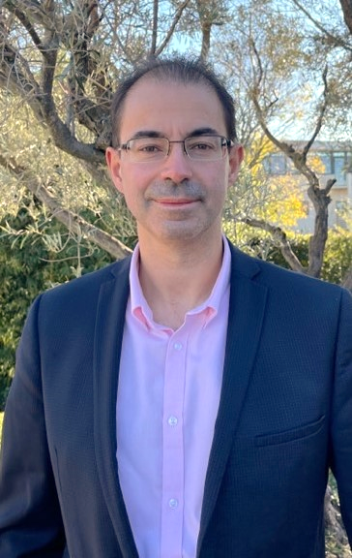
LEADERSHIP TEAM
Davy Théophile
Hydro & Marine
Neil Wilkinson
Wiring System
Yves Barraquand
Chief Executive Officer
Coralie Monnot
Human Resources
Stéphan Truchot
Finance
Julien Moynet
Research & Development
Yann SULTAN
Electronics & Sensors
Jean-François Michel
Supply Chain
Prasad PALIYATH
Offshore
Serge Maurey
Digital
4

Slide 5
An international presence
95% of its annual turnover is generated internationally.
1 000 employees in 13 subsidiaries worldwide.
Thanks to this strong local anchoring, CMR benefits from design, production and logistics capabilities on 4 continents.
Newcastle
CMR Group is currently made up of 4 brands:
CMR Group, headquartered in Marseilles,
Procaly, specialist in electrical wiring in high-stress environments, particularly in rail and defense
Costronic, a Swiss specialist in engineering and control-command of hydraulic power plants,
Greenelec, a Nigerian solar solutions company.
Vourles
Lausanne
Pittsburgh
Marseille
Tunis
Busan
Hergla
Suzhou
Pune
Manille
Lagos
Singapour
5

Slide 6
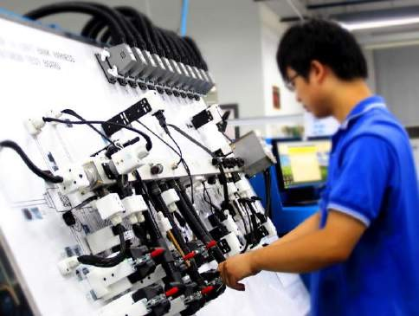
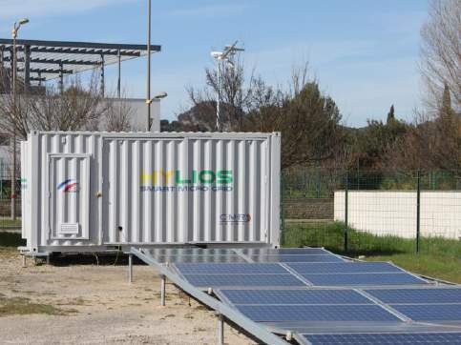
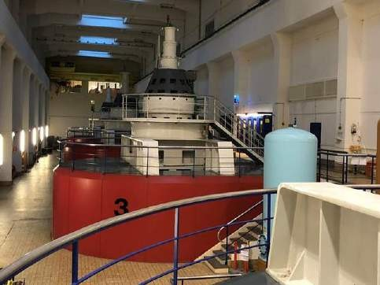
Who are we?
CMR Group is a key player in the field of instrumentation, automation and control systems; it offers advanced solutions to reduce emissions from Diesel and Gas engines.
The growth of the high-power engine market is driven by the need to reduce emissions to comply with more stringent regulations.
CMR Group has developed a strong
know-how in the
management of solar-Diesel hybrid systems.
With the acquisition of Costronic, CMR Group becomes a key player in the hydropower market.
6

Slide 7
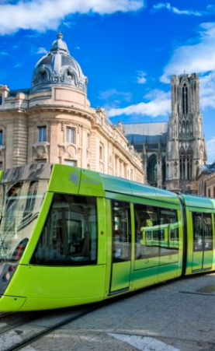
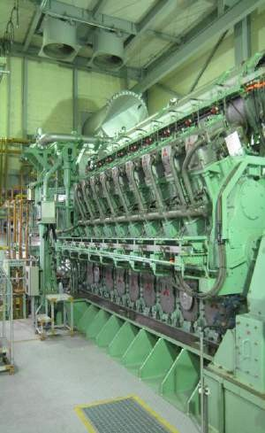
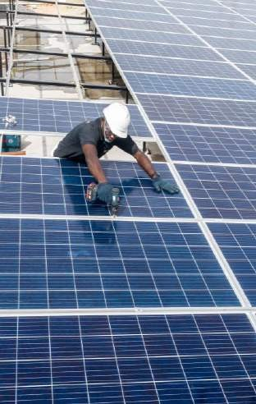
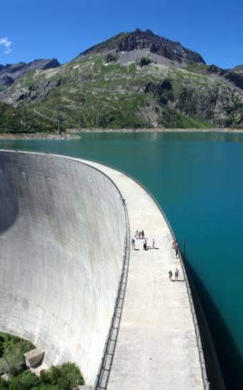
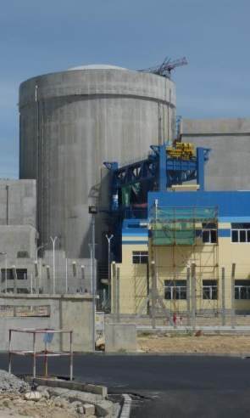
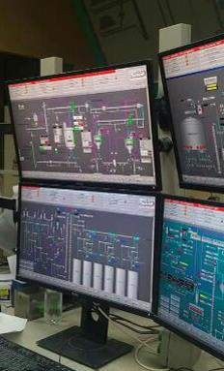
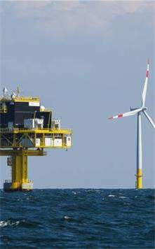
Our business lines
CMR develops tailor-made, turnkey solutions to address the most complex issues of its clients.
RAIL & DEFENSE
Harnesses and connected boxes for rail and defense
ENGINES
Instrumentation and communication for high-power engines
SOLAR
Solar or hybrid, micro-grid, industrial or connected power plants.
MARINE
Command and control systems to guarantee the reliability of installations.
OFFSHORE
Electrical switchboards, control and automation systems..
HYDRO
Automation and electrical engineering for hydroelectric power plants.
NUCLEAR
Measuring and automation instruments for nuclear power plants.
7

Slide 8
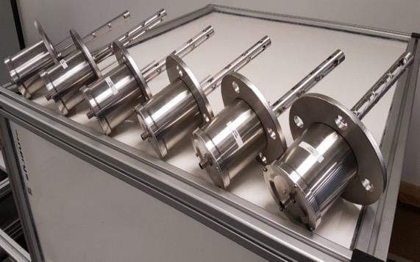
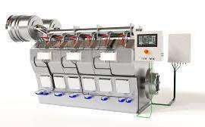
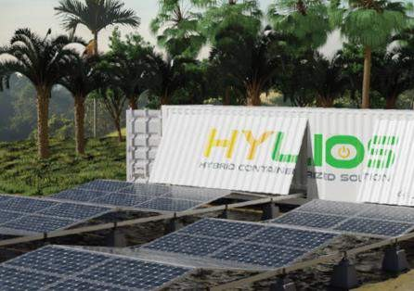
Innovation to serve the energy transition
CMR mobilises its expertise to reduce its client’s carbon footprint, thanks to solutions such as:
The Niris Gas sensor
measures the quality of natural gas fuel in real time for better engine performance (patented technology).
The new generation E-pulse engine control system
is easily installed and extends the service life of engines.
The Hylios containerised solar mini-power plant
allows the production of solar energy, as well as its storage and hybridization with thermal generation, for the power supply of isolated areas.
8

Slide 9
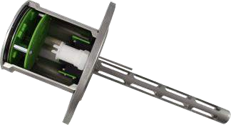
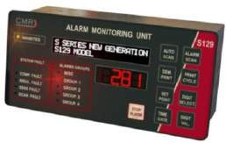
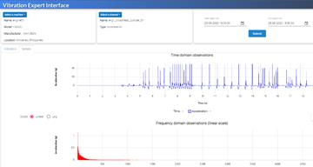
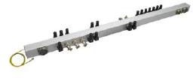
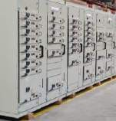
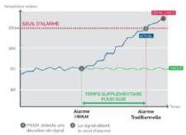
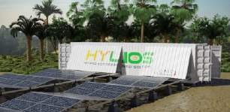
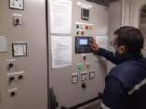
Our Products
CMR offers a wide variety of products, ranging from electrical harnesses to sensors and Energy Management Systems (EMS).
SENSORS
For industrial, Diesel, Dual fuel and Gas engines
WIRING
Rigid and flexible pre-
wired wiring solutions
MONITORING
Engine control and monitoring system with alarm
VIBRATION
Vibration monitoring system
ENERGY MANAGEMENT
Power supply management system
- Control and Data Acquisition (SCADA))
ELECTRICAL
SWITCHBOARDS
LV & MV switchgear and transformer
PREDICTIVE
MAINTENANCE
Predictive maintenance system
SOLAR MINI- POWER PLANT
Solar panel solution and containerised storage

Slide 10
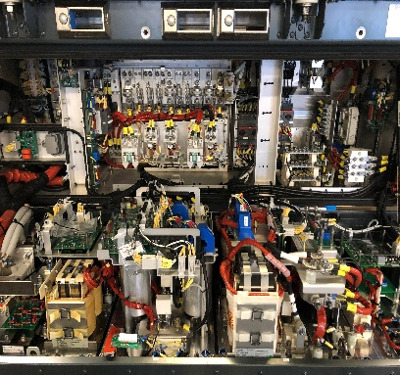
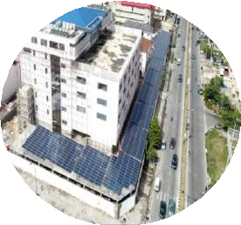
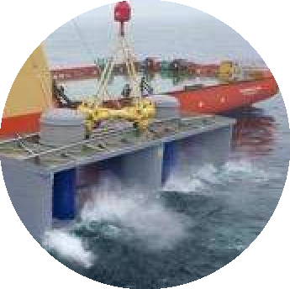
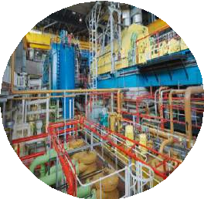
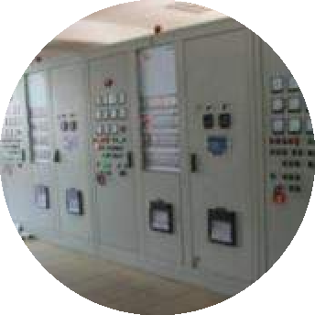
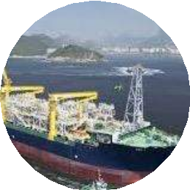
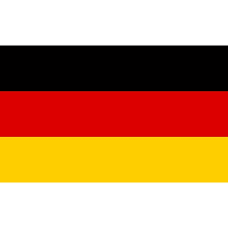
Examples of projects carried out by CMR
HYDRO
For the ENAG company, design and commissioning of water turbine control systems.
RAIL
Assembly, cabling, integration and tests on the contactor box for the Neoval metro for Siemens.
SOLAR
PV system (700kWp) hybridized to existing Diesel generator (4MVA) - from the design to the installation for Century21
NUCLEAR
Instrumentalization and monitoring solutions for backup Diesel generators.
INDUSTRIAL
For the AIS Group, design and commissioning of Diesel engine instrumentalization and control systems.
OFFSHORE
Construction and installation of low voltage switchboards for a floating production, storage and unloading platform
Frankfurt, Germany
Lagos,
Nigeria
Cherbourg, France
French nuclear power plants
Kaloum, Guinea
Brazil

Slide 11
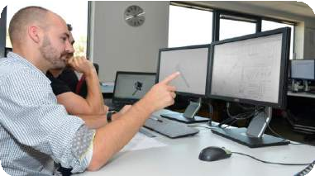
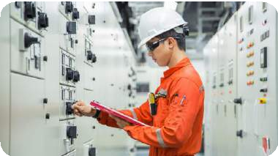
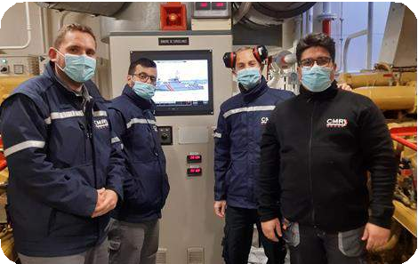
Our Services
Teams are at the disposal of our clients from project engineering to after-sales service, all over the world.
Engineering
Custom 3D design & capacity studies with the ability of deploying design teams on site at the client's premises
Commissioning
Installation and testing of systems designed by CMR with the involvement of certification bodies
Maintenance
Intervention of our on-site teams and equipment retrofitting operations all over the world
After-sales service
Telephone support within 24 hours and shipment of spares parts (more than 2,000 spare parts are supplied per year)

Slide 12
Wiring System
Our engineering capacities

Slide 13
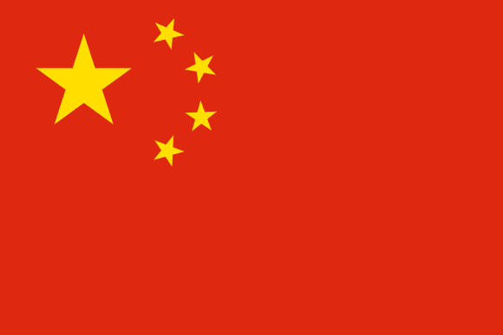
Wiring System Engineering
Specialist in design and manufacture of wiring harness for harsh environments Typical applications Marine, Mining, Oil and Gas, Power Generation
54 engineers
Project, Design, Manufacturing
Newcastle
Vourles
Pittsburgh
Marseille
Tunis
60+ years of experience
Suzhou
Busan
Hergla
Pune

Slide 14
Engineering project stage-gate process driving efficiency
G1
Phase 2 Development
G2
Phase 3 Production
G3
Serial Production
Bid No Bid
Phase 1 Quote

Slide 15
Fields of expertise
Harness Design Global team with significant knowledge and experience in Engine applications and 3D tools
Project Engineering Seamless Integration with customers and dedicated project teams
Manufacturing Engineering
Process and product development
IPC 620 C certified engineers and production staff
APQP Advanced product quality planning

Slide 16
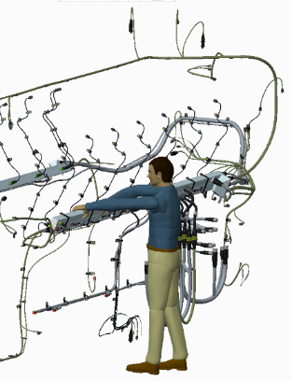
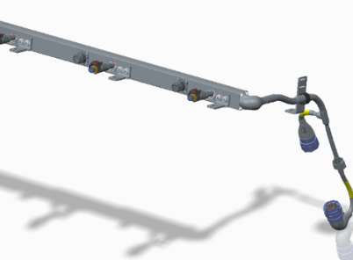
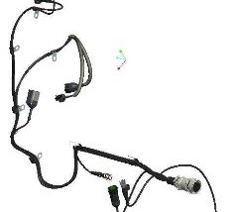
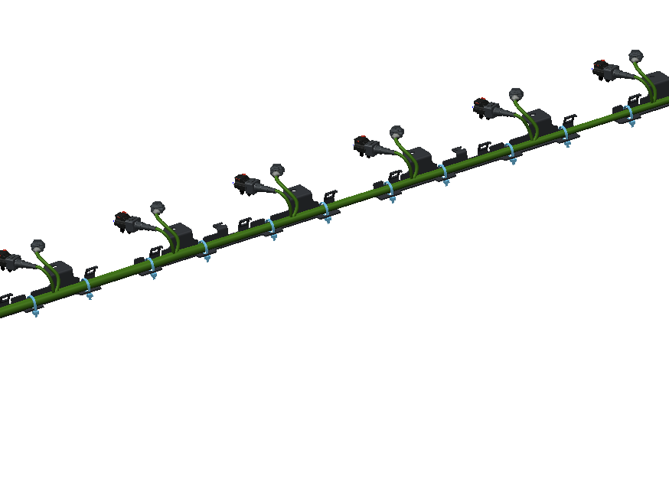
Harness capabilities
Plug and play solutions
Braided
Conduit
Rigid
Heatshrink
Bespoke mounting solutions
Vast experienced with complex circuit design, splicing, shielding, and CAN networks.

Slide 17
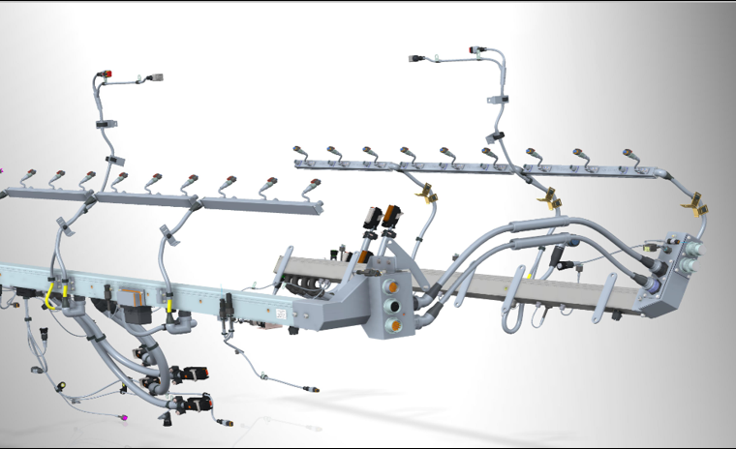
CMR Rigid-pipe wiring system
‘Pipe Harness’ foam filled for harsh environments
CMR 3D Model design
Prototype development and validation including on site fit check
Project management from RFQ to approval and production ramp up

Slide 18
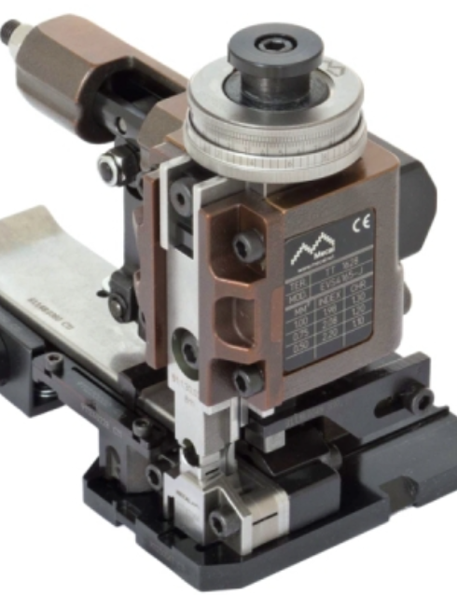
CMR Harness Assembly
Automated crimping and wire prep
USW (Ultra Sonic Weld) splicing
Bespoke assembly and test boards
Continuity and Hi Pot testing
Full SPC (Statistical Process Control)
APQP (Advanced Product Quality Planning)

Slide 19
Harnesses & Cabling
More than 50,000 electrical harnesses are assembled each year in all our subsidiaries.
Connection pipes (Rigid Systems) (CP, CT, CPT, CTC)
Wiring Harnesses
Plastic Pipe Harnesses
Braided Harnesses
Combined and/or onboard Wiring Systems (Pipes & Harnesses)
Micro wrapping
CP
CTC
Micro wrapping
On-board wiring
Plastic Pipe Harnesses
Braided Harnesses

Slide 20
Our training center
Go further by supporting all those wishing to train in the requirements of our profession and to share our passion with you
Avalaible trainings
IPC/WHMA-620 (CIS)
IPC-A-610 (CIS)
2 formulas
Test Challenge (Certification only over 8 hours)
Intensive (Training + certification over 3 days)
Terms
Inter & Intra
face-to-face
3 to 8 people
Location: Vourles (69) - elsewhere on request

Slide 21
Our Production Capacity
CMR is organised around a “Glocal” model; the majority of our sites provides local manufacturing support. This is an advantage for
our international clients: design, engineering and manufacturing capabilities are spread across four continents.
Therefore, products or solutions developed in any region of the world can then be prototyped and manufactured locally in one of our sites to meet the needs of our clients in terms of costs and delivery.
This diversity also allows us to adapt to large production volumes, even with short lead times.

Slide 22
3 production sites
More than 700 employees dedicated to production in Tunisia, China and India.
CMR Chine, Suzhou
144 employees including 88 skilled workers
30 machines on a 3,600m²
production area
CMR Tunisia, Tunis & Hergla
570 employees including 417 skilled workers
78 machines on a 2,450m² production area in Tunis and 100 employees including 82 skilled workers, 20 machines on a 2,400m² production area in Hergla
CMR Inde, Pune
20 employees including 10 skilled workers
17 machines on a 1,700m² production area

Slide 23
Our Supply Chain
CMR places agility at the heart of its supply chain to better serve customers and control its costs.
Global purchasing strategy with suppliers as
close as possible to factories
Supply Chain organized around production centres with direct deliveries to clients to reduce delivery times and our carbon footprint
Common ERP with harmonized processes for all subsidiaries, allowing optimal management of our stocks and orders

Slide 24
Electronics & Sensors
R&D capacities

Slide 25
Our products
More than 60,000 sensors are produced each year in all our subsidiaries.
MD43
MBT35
Engine sensors
Exhaust temperature sensors (MD1, 2, 43)
Low temperature sensors (MBT19, MBT35)
Bearing temperature sensors (MP12, 39, 46)
Knock sensors (CVB)
Nuclear sensors
LNG sensors
Sensors for the French Navy
Special sensors: Niris Natural Gas
MP39
CVB

Slide 26
Our products
Analog & digital displays
TC3
LDU
Since 1975
Since 2008
Thermocouple analog display
Local display unit for ship cabins

Slide 27
Our products
Monitoring & Supervision
S127
S12x series
Clarine
Since 1986
Since 1985
Since 1999
Local unit for thermocouple channel monitoring
Local display unit with advanced features
SCADA system

Slide 28
Our products
Signal conversion
MBT19mA
ConvertorBox
ConnectCAN
Since 1996
Since 1999
Since 2012
Fluid and gas temperature sensor with current output
Bespoke converter for thermocouple sensors
Digital temperature sensor

Slide 29
Our products
Power management
Power Distribution Module
Since 2006
Bespoke power distribution manager for engine start

Slide 30
Our products
Gas quality sensor
NIRIS
Since 2022
Infrared spectrometer for natural gas quality measurement

Slide 31
R&D in France
7 engineers
30+ years of experience
Budget 1M€ yearly

Slide 32
Fields of expertise
Electronics
PCB design
Software
Embedded
Desktop
Web
Opto-mechanics
Optical sensor design
Spectroscopy

Slide 33
Our Laboratory
Defective products
expertise
Approvals management
Equipement metrology
Products qualification

Slide 34
Power Solutions
Solar

Slide 35
Solar Hybrid: A portfolio of innovative solutions to serve the energy transition
Commerce &
Industry
We offer the C&I sector solar solutions, whether on the roof, on the ground or on a shade structure, for a competitive and reliable supply of green electricity.
Energy Efficiency
We integrate energy
efficiency solutions for commercial or industrial buildings to sustainably
reduce the electricity bill.
Rural Electrification
We develop electrification
projects for hospitals, universities or villages with our hybrid solar solutions in containers or on the ground.

Slide 36
Solar Hybrid: Our Strategy
To be a key player in the C&I Solar Hybrid (Commercial & Industrial) market
CMR Group is a developer and an EPC
company (Engineering, Procurement and
Construction) for public and rural electrification
projects with powers ranging from 10kW to 10MW.
CMR Group acts as a project developer and
EPC for commercial and industrial clients in Africa and Southeast Asia.
CMR Group offers “energy as a service” to its
private clients and Public Private Partnerships
for its public partners.

Slide 37
Solar Hybrid:
A highly competitive market
Our assets that makes the difference
A specialized team with a strong knowledge of the target market
A team of solar engineers at competitive cost
A supply chain on a global scale
A network of international and local partners
Ability to invest in hybrid solar projects

Slide 38
Solar Hybrid:
Our Clients and Partners
CMR continues its development in the renewable energy sector by building partnerships with local and international players.
Together with our technical partners, we are committed to:
the access to new markets through C&I customer prospecting and rural electrification programmes
a competitive and efficient supply chain and logistics
the training of teams in auditing, engineering and construction of solar installations
the access to project financing
Our clients: CMR in collaboration with its technical partners is currently building, operating or developing solar projects
Nos partenaires financiers
Nos partenaires techniques
1₁₃3

Slide 39
Solar Hybrid:
Target Markets
Morocco
Tunisia
We are developing opportunities in 2 geographical areas: Sub- Saharan Africa and the Philippines.
Western Sahara
Algeria
Libya
Egypt
Mauritania
Mali
Senegal
Niger
Burkina
^{Benin} Nigeria
Chad
Sudan
Guinea
Liberia ^{Cote Ghana}
Central African Republic
Ethiopia
d’Ivoire
Cameroon
CMR Group is particularly mobilised in Africa, in the development of solar projects in the C&I and rural electrification sectors.
We prospect as a priority in 6 target countries: Senegal, Ghana, Nigeria, Burundi, Kenya and Tanzania responding to the following criteria:
High electricity price in the C&I sector (> 0.13$/kWh)
Regulatory framework for self-consumption
Growth of the industrial sector (agro-industry, textiles, heavy industry, pharma…)
Presence of private and public investors
CMR Philippines is developing the solar hybrid business for its commercial and industrial clients locally.
Equatorial Guinea
Gabon
Uganda _{Kenya}
Rwanda
Burundi
Tanzania
DRC
Angola
Malawi
Zambia
Mozambique
Namibia
Zimbabwe
Madagascar
Botswana
Lesotho South Africa
Key
Target countries with significant ongoing or potential solar projects.

Slide 40
Power Solutions
Hydro

Slide 41
Hydro:
, a recognised know-how
Introducing Costronic
Created in 1986
+€4M in turnover
Head Office at Lausanne (Switzerland)
Turnkey solutions and after-sales service for the control and supervision of hydroelectric power plants dedicated to :
Powers from 1MW to 400MW with 2,800MW of installed capacity
Water treatment systems
Low and high voltage electrical distribution.
15 employees

Slide 42
Hydro:
Our Roadmap
Morocco
Algeria
Tunisia
Valuing Costronic's skills and CMR Group's resources.
Western Sahara
Libya
Egypt
Mauritania
Mali
Niger
Senegal
Guinea
Burkina
^{Benin} Nigeria
Chad
Sudan
CMR Group and Costronic act jointly on new or rehabilitation projects.
Central African Republic
_{Liberia} Cote Ghana
d’Ivoire
Ethiopia
In partnership with wind turbine manufacturers and construction
companies specialising in hydraulics.
On powers ranging from 1MW to 20MW.
By mobilising the engineering capabilities of both companies in Switzerland, France and Tunisia.
By relying on the CMR Group's Supply Chain, and its switchboard assembly
and sourcing capabilities.
Cameroon
Equatorial Guinea
Gabon
Uganda _{Kenya}
Rwanda
Burundi
Tanzania
DRC
Angola
Malawi
Zambia
Mozambique
Namibia
Zimbabwe
Madagascar
Botswana
Lesotho South Africa
We are prospecting as a priority in 7 target countries in Africa: Ghana, Nigeria, Burundi, Democratic Republic of Congo, Cameroon, Ivory Coast and Kenya.
CMR Group and Costronic also respond to some calls for tenders in Europe, in its
periphery and in the overseas territories.
Legend
Target countries

Slide 43
Our Talents

Slide 44
Our Commitment
CMR continuously strives to create an environment promoting exchanges, especially between the different sites and departments, in order to best support its evolution, but also the personal and professional development of its employees.
Employee Experience: we facilitate the experience of our employees, in particular through the digitalization of our processes and tools as well as a modern approach to human resources
A caring work environment with multiple events and activities organised throughout the year to meet the most varied needs and a continuous development of the skills of our managers thanks to evaluation and training tools
Talent Development by providing access to quality training, but also by making our employees aware of the importance of “soft skills”, which are an integral part of our annual evaluations and our values, and by favouring internal promotions, thus giving our high potentials opportunities to evolve within the company

Slide 45
Recruitment & Diversity
Joining CMR means joining a company with a strong entrepreneurial culture that wishes to promote intrapreuneurship by maintaining a privileged link with the world of start-ups but also by encouraging versatility and the taking of responsibilities by our employees.
Recruitment capabilities in our subsidiaries but also via
partners such as Business France for greater flexibility.
A wide variety of profiles at CMR: 1 000 employees of whom 43% are women, and more than 24 nationalities. This diversity helps to encourage creativity and innovation, and also enables us to identify and seize opportunities more quickly.
A common and complete integration process, via e-learning, for all subsidiaries to ensure rapid operationality of newcomers.

Slide 46
Talent and Performance Management
Each employee benefits from a follow-up of his objectives formalised with his manager as well as from tools to support him in his development, as soon as he joins the company.
A common human resources management tool for the group, named
Talent Soft, to ensure harmonised process management:
Talent and Performance Review
Succession plan
Job profiles
E-learning
But also, tools such as the 360 feedback, the personalized performance support plan, the calibration meetings, to bring our employees to the level of performance expected on their position.

Slide 47
Quality of life at work
Multiple events organized internally throughout the year to promote exchanges and cohesion
An annual “People Survey” on all sites with an action plan to improve the points of vigilance identified
A “Net Promoter Score” (NPS) calculated each year to track employee involvement
30

Slide 48
CSR
Strategy
We analyse the impact of
CMR on the environment,
the economy and the social
sphere with one major
concern: reduce carbon footprint.
31

Slide 49
Environment
Customers direct shipment from production sites to reduce CMR's carbon footprint.
Innovation program related to the energy transition.
Train our engineering team and R&D collaborators in product lifecycle analysis.
Track the recycling of our waste in production and in offices.
Reduce, or even eliminate, the use of plastic packaging.
32

Slide 50
Economy
Purchases as close as possible to production sites
Prevent the risks of corruption by signing a Code of Conduct when employees are hired and by following an e-learning training in all subsidiaries
33

Slide 51
Societal
Talent development and professionalisation, in all countries where CMR operates through formalized succession plans for key positions and exchange programs to discover different professions
The health of our employees is a priority: each subsidiary works on a health cost coverage programme and promotes access to sport

Slide 52
Learn more about our activities
Sensors & Electronics
Wiring Systems
Power Solutions
Jérôme VAN DEN BROECK « Wiring Systems » Defense & Rail
Yann SULTAN « Electronics, Sensors &
Nuclear »
Davy THEOPHILE
« Hydro & Marine»
Prasad
PALIYATH
« Offshore »
Neil WILKINSON
« Wiring Systems »
Engine & Rail
John OKORO Business Development « Solar»
neil.wilkinson@cmr-group.com
jvandenbroeck@procaly.com
Yann.sultan@cmr-group.com
John.okoro@cmr-group.com
davy.theophile@cmr-group.com
joseph.alemberg@cmr-group.com

Slide 53
THANK YOU
May 2021
36

